Slide 1
Seoul Bike Demand Prediction
Group 2:
Andrea Franco, Andres Salguero, Harpreet Kaur

Slide 2
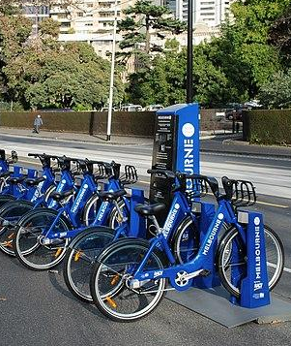
I) Business Case Evaluation
Project Scope: Predict bike rental demand in Seoul, Korea.
Problem: Inconsistent bike availability leads to lost revenue and customer dissatisfaction.
Solution: Develop a bike rental demand prediction model using historical data and weather information.
Goals:
Reduce lost revenue by predicting peak demand periods.
Improve customer satisfaction by minimizing wait times and ensuring enough bikes.
KPIs (to evaluate model performance):
Bike rental revenue
Bike availability (especially during peak hours)
Customer satisfaction surveys

Slide 3


II) Data Identification
Dataset: "Seoul Bike Sharing Demand Prediction" ([E et al., 2020]) from Kaggle
Historical public bike rental from the government of Korea and weather information (Temperature, Humidity, Windspeed, Visibility, Dewpoint, Solar radiation, Snowfall, Rainfall).
For a more robust model: Use of additional data sources (internal & external).
Internal Data Sources (Bike Rental Company)
External Data Sources (Weather)

Slide 4
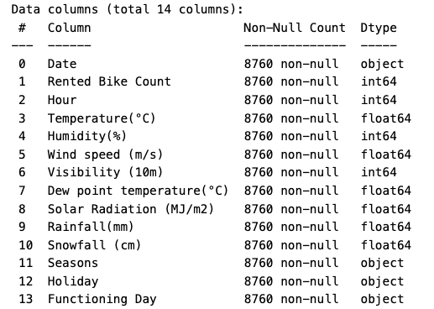

III) Data Acquisition and Filtering :
The Data was acquired from the dataset "Seoul Bike Sharing Demand Prediction" from Kaggle, in the format of csv, and read as dataframe using pandas.read_csv

Slide 5
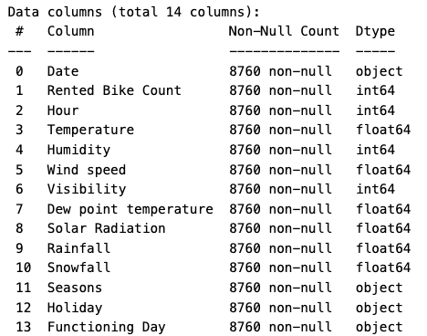
IV) Data Extraction :
To transform data into a consistent format, the date column will be converted to a datetime object. This allows to efficiently handle, manipulate, and extract useful features from the date information.
For this stage, we decided to remove special characters from dataset labels to simplify the referencing in code, ensuring compatibility with various tools and systems, improving readability and maintainability, and avoids potential issues with database integration and data analysis operations.

Slide 6

V) Data Cleaning And Validation :
Data cleaning and validation are crucial steps in the data analysis lifecycle because they ensure that the data used for analysis is accurate, reliable, and suitable for making informed decisions.
The Key Steps Taken for cleaning our dataset include are:
Checking for null values using df.isnull().sum()
Verified uniqueness with df.nunique()
Transformation Applied by converting Qualitative feature (Seasons,Holidays,Functioning Day) into Quantitative feature using Label Encoder()

Slide 7
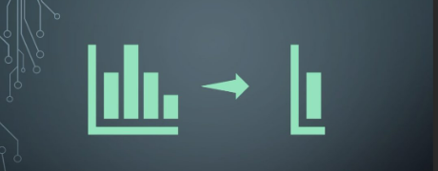
VI) Data Representation and Aggregation:
Data aggregation is basically a process to combine multiple datasets into one single dataset and summarising it to support analysis and decision making.This step is important because it eases to access and perform statistical analysis on large amount of dataset in order to gain a holistic view of your business and thereby help in making informed decision making.
In our Project this step will not be included as our dataset is already in consolidated format(single csv ) so there is no need for aggregation as dataset is singular and comprehensive

Slide 8

VII) Data Analysis

Slide 9
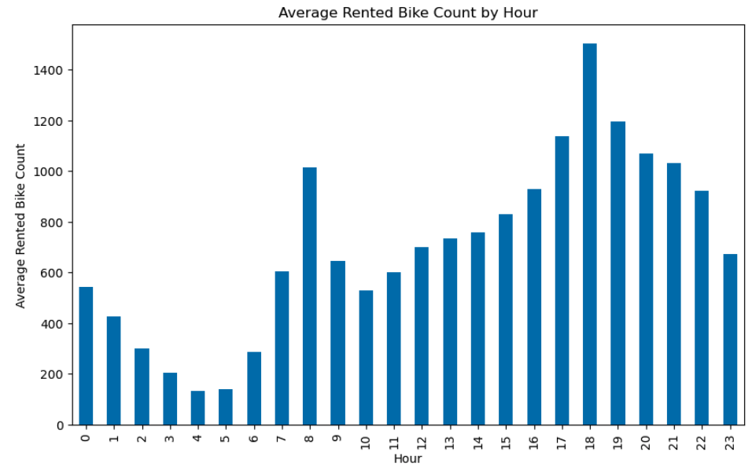
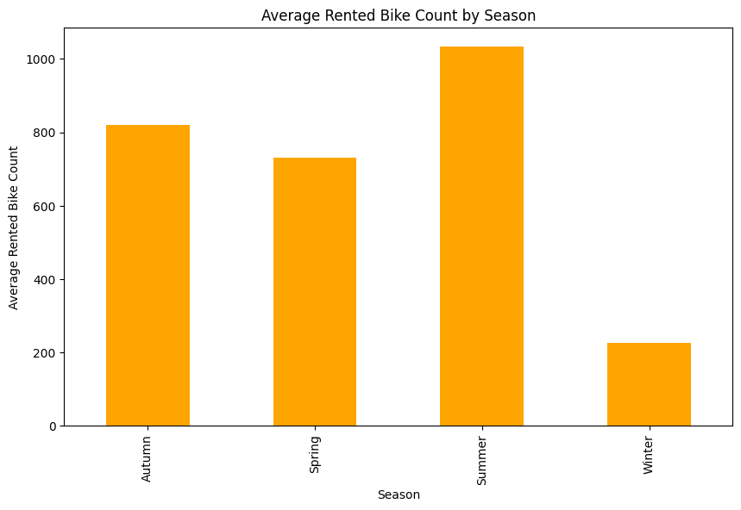
Target Variable Exploration
The target variable, Rented Bike Count, represents the number of bikes rented per hour. Accurate predictions of this target variable will help the bike rental shop manage inventory more efficiently.
The time series analysis of the target variable, Rented Bike Count, will provide insights into the trends, seasonality, and patterns in bike rentals over time.

Slide 10
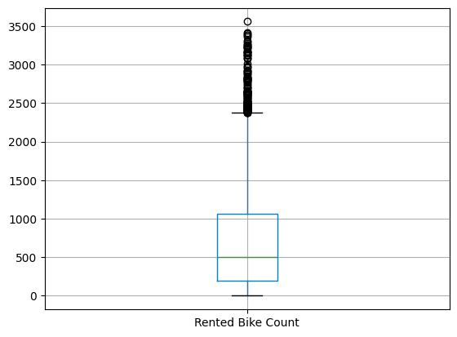
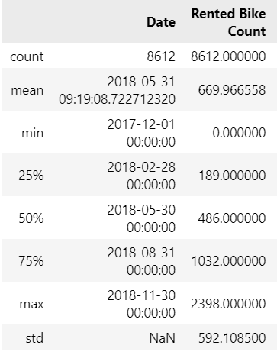
Target Variable Exploration
As the values above 2400 only represent a 1.68 % of the data they can be considered outliers and we can remove them as they may affect our prediction results.

Slide 11
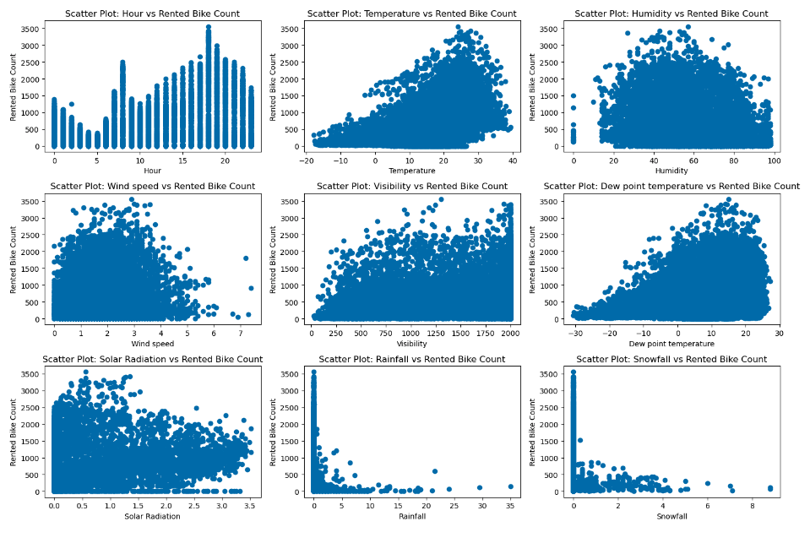
2. Numerical Variable Exploration:
Numerical columns were extracted to run a scatter plot for all the numerical features against the target ‘Rented Bike Count’

Slide 12
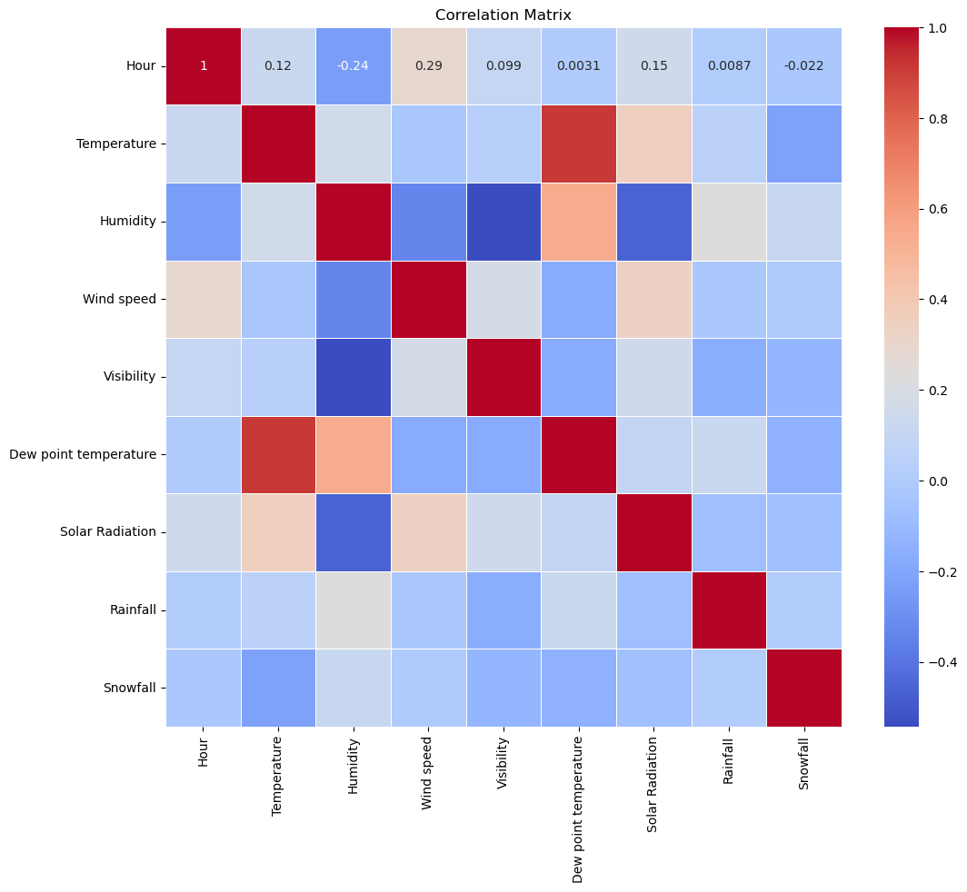
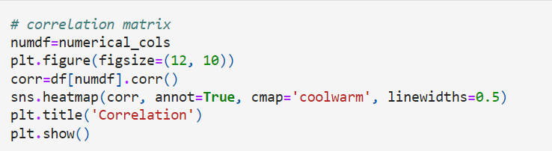
3. Finding Correlation between variables:
Correlation defines the relationship between two or more variables. It depicts how the change in one variable affect the change in another variable. It is useful for discovering patterns which can lead to valuable insights and predictions.
corr() function is used for finding the correlation.
Heatmap depicts correlation between numerical variables
Colors indicate the strength and direction of correlations
‘Temperature’ and ‘Solar Radiation’ have Positive correlation
‘Humidity’ and ‘Visibility ’ have negative correlation

Slide 13
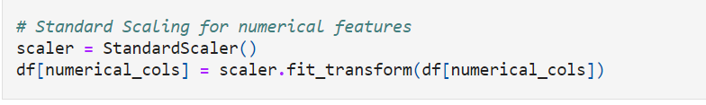
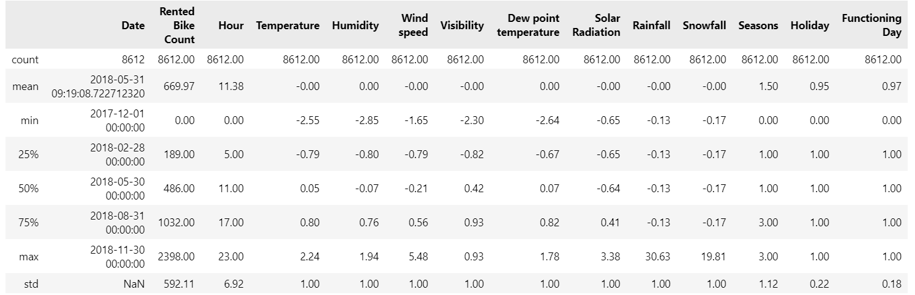
4. Normalizing values:
Normalization is form of feature scaling that transforms the range of feature to a standard scale.

Slide 14
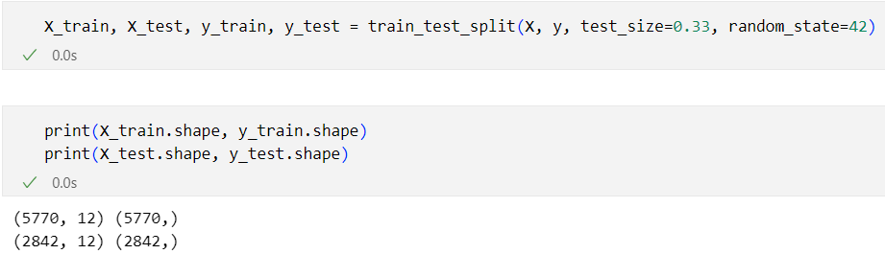
5. Splitting the data
Once the data is normalized, we proceed to split it the features in a X variable and the target feature in a Y variable. After this, we can split the two parameters into the train and test subsets, being test the 33% of the total data.

Slide 15
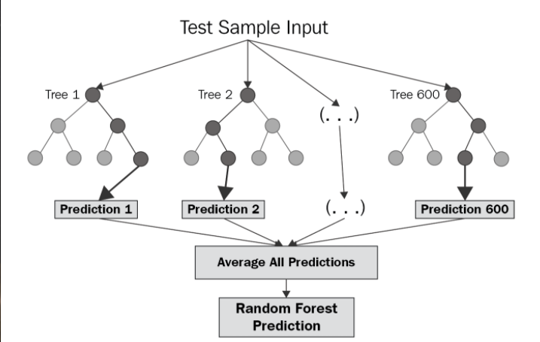
6. Machine learning model: Random Forest Regressor
Random Forest Regression is an ensemble technique used for predicting continuous numerical values. It works by combining the predictions of multiple decision trees, reducing overfitting and improving the model's overall accuracy.
Ensemble method combining predictions from multiple decision trees.
Leverages the strengths of various models for improved performance.
Reduces overfitting and improves accuracy.
Image source: https://levelup.gitconnected.com/random-forest-regression-209c0f354c84

Slide 16
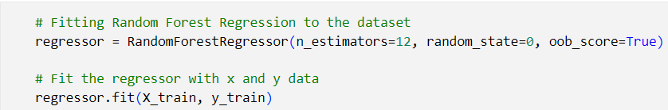
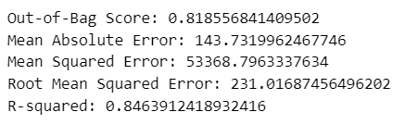
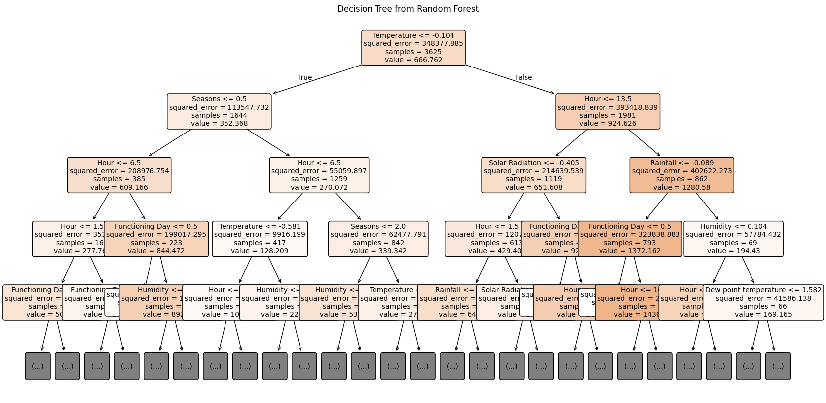
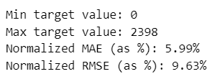
6. Machine learning model: Random Forest Regressor

Slide 17
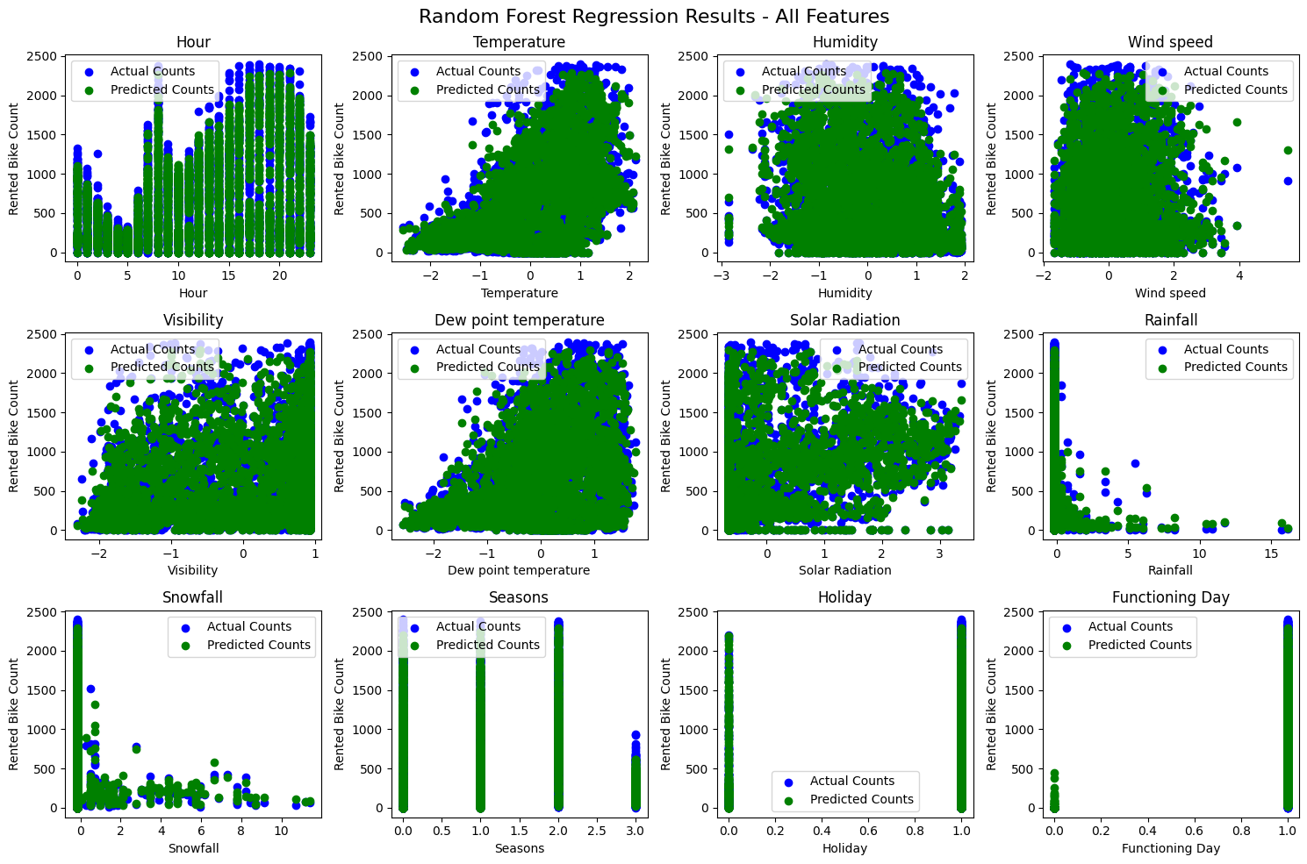

Slide 18

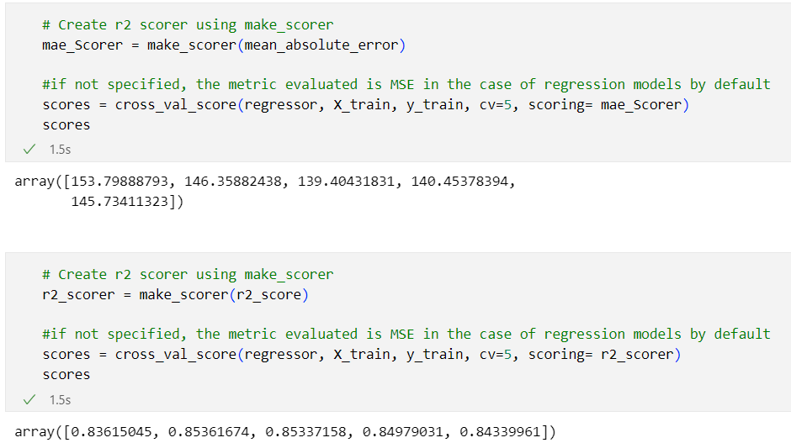
7. Perform a Cross-validation technique

Slide 19
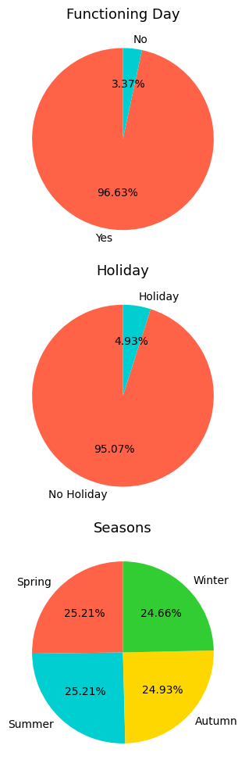
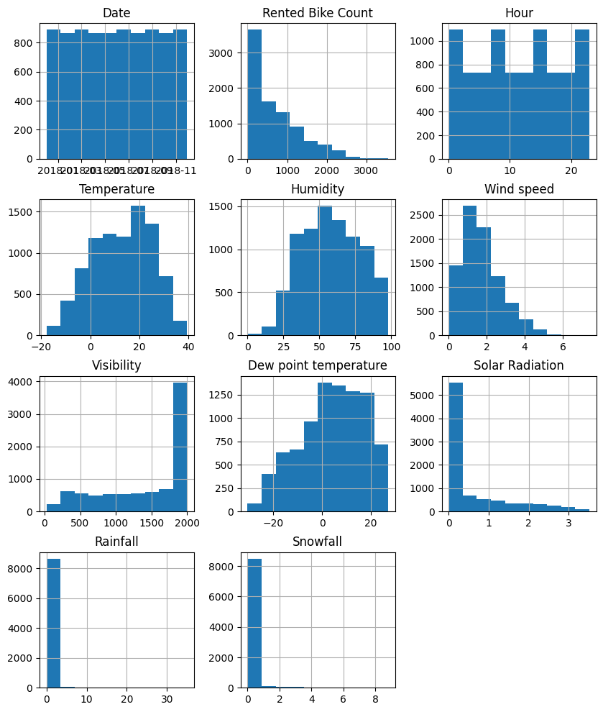
VIII) Data visualization
frequency of the numerical data
Percentage of each class from the categorical variables.

Slide 20
IX) Utilization of Analysis Results:
As per the results, we can demonstrate that our model is feasible for anticipating bike rental demand. The lower Mean Squared Error (MSE) and Root Mean Squared Error (RMSE) depict that our predictions coordinate with real values, indicating higher accuracy. This precision empowers businesses to form strategic/educated choices with respect to inventory, operations, and various other aspects that will help in meeting the predicted demands.
Additionally, the OOBs score is 0.818 which shows our model is comprehensive enough for unseen data, therefore helps in mitigating risks. This accurate data helps the marketing department in achieving customer satisfaction and organization goals.
Moreover, while the model performs decently (82% explanation of variance), the error (MAE of 143) is significant in the context of our problem (average bike count of 700). This means predictions could be off by an average of 20%, which might not be acceptable. There's room for improvement by tuning the model or adding more data could bring the MAE down.
To conclude, the model's forecasted data elucidate that lower MSE, RMSE, and a respectable OOB score, leads to a strong foundation for discovering insights into business operations, specifically in effectively managing resources and enhancing customer-oriented proposals.
How ever, the model must be used with caution in some cases, specially in the low bike renting season, as the error could be unacceptable for those cases.

